Slide 1
Image Enhancement
Module - 4

Slide 2
What is Image Enhancement?
Image Enhancement: is the process that improves the quality of the image for a specific application.

Slide 3
Image Enhancement Methods
Spatial Domain Methods (Image Plane)
Techniques are based on direct manipulation of pixels in an image
Frequency Domain Methods
Techniques are based on modifying the Fourier transform of the image.
Combination Methods
There are some enhancement techniques based on various combinations of methods from the first two categories

Slide 4
Spatial Domain Methods
Spatial domain refers to the aggregate of pixels composing an image. Spatial domain methods are procedures that operate directly on these pixels. Spatial domain processes will be denoted by the expression:
g(x,y) = T [f(x,y)]
where, f(x,y) in the input image, g(x,y) is the processed image and T is as operator on f, defined over some neighborhood of (x,y)
In addition, T can operate on a set of input images.

Slide 5
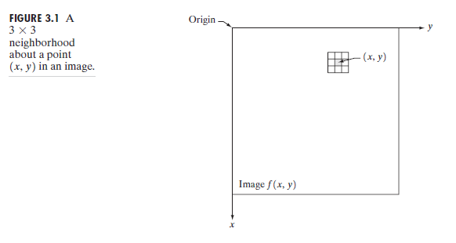
Example:
The simplest form of T, is when the neighborhood of size 1x1 (that is a single pixel). In this case, g depends only on the value of ‘f’ at (x,y), and T becomes a grey-level (also called intensity or mapping) transformation function of the form:
s = T (r)
Where, for simplicity in notation, r and s are variables denoting, respectively, the grey level of f(x,y) and g(x,y) at any point (x,y)

Slide 6
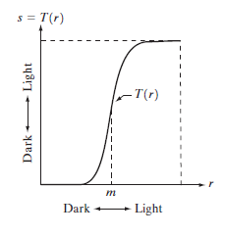
Examples of Enhancement Techniques
Contrast Stretching:
If T(r) has the form as shown in the figure below, the effect of applying the transformation to every pixel of f to generate the corresponding pixels in g would:
Produce higher contrast than the original image, by:
Darkening the levels below m in the original
image
Brightening the levels above m in the
original image
So, Contrast Stretching: is a simple image
enhancement technique that improves the contrast
in an image by ‘stretching’ the range of intensity values it contains to span a desired range of values. Typically, it uses a linear function

Slide 7
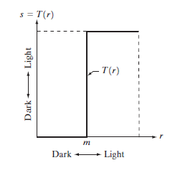
Examples of Enhancement Techniques
Thresholding
Is a limited case of contrast stretching, it produces a two-level (binary) image.
Some fairly simple, yet powerful, processing approaches can be formulated with grey-level transformations. Because enhancement at any point in an image depends only on the gray level at that point, techniques in this category often are referred to as point processing.

Slide 8
Examples of Enhancement Techniques
Larger neighborhoods allow considerable more flexibility. The general approach is to use a function of the values of f in a predefined neighborhood of (x,y) to determine the value of g at (x,y).
One of the principal approaches in this formulation is based on the use of so-called masks (also referred to as filters)

Slide 9
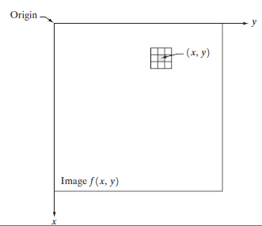
Examples of Enhancement Techniques
So, a mask/filter: is a small (say 3X3) 2-D
array, such as the one shown in the
figure, in which the values of the mask
coefficients determine the nature of the
process, such as image sharpening.
Enhancement techniques based on this
type of approach often are referred to as
mask processing or filtering.

Slide 10
Some Basic Intensity (Gray-level) Transformation Functions
Grey-level transformation functions (also called, intensity functions), are considered the simplest of all image enhancement techniques.
The value of pixels, before an after processing, will be denoted by r and s, respectively. These values are related by the expression of the form:
s = T (r)
where T is a transformation that maps a pixel value r into a pixel value s.

Slide 11
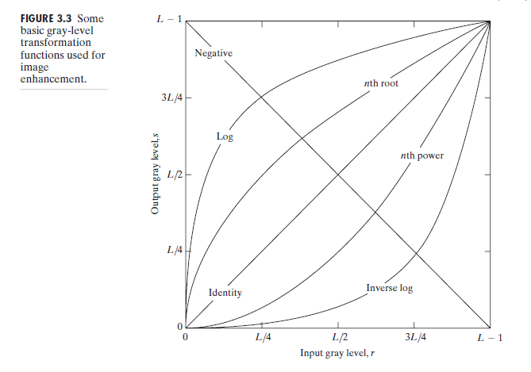
Some Basic Intensity (Gray-level) Transformation Functions
Consider the following figure, which shows three basic types of functions used frequently for image enhancement:

Slide 12
Some Basic Intensity (Gray-level) Transformation Functions
The three basic types of functions used frequently for image enhancement:
Linear Functions:
Negative Transformation
Identity Transformation
Logarithmic Functions:
Log Transformation
Inverse-log Transformation
Power-Law Functions:
n^{th} power transformation
n^{th} root transformation

Slide 13
Linear Functions
Identity Function
Output intensities are identical to input intensities
This function doesn’t have an effect on an image, it was included in the graph only for completeness
Its expression:
s = r

Slide 14
Linear Functions
Image Negatives (Negative Transformation)
The negative of an image with gray level in the range [0, L-1], where L = Largest value in an image, is obtained by using the negative transformation’s expression:
s = L – 1 – r
Which reverses the intensity levels of an input image, in this manner produces the equivalent of a photographic negative.
The negative transformation is suitable for enhancing white or gray detail embedded in dark regions of an image, especially when the black area are dominant in size

Slide 15
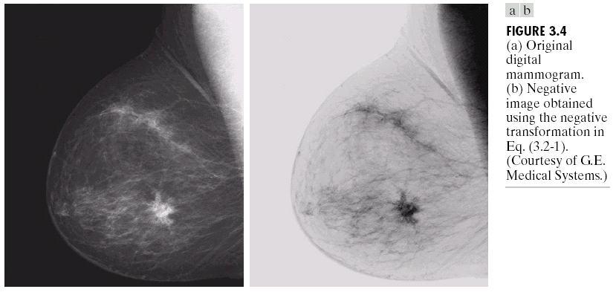
Image Negative
Image Negative: s = L – 1 – r

Slide 16
Logarithmic Transformations
Log Transformation
The general form of the log transformation:
s = c log (1+r)
Where c is a constant, and r ≥ 0
Log curve maps a narrow range of low gray-level values in the input image into a wider range of the output levels.
Used to expand the values of dark pixels in an image while compressing the higher-level values.
It compresses the dynamic range of images with large variations in pixel values.

Slide 17
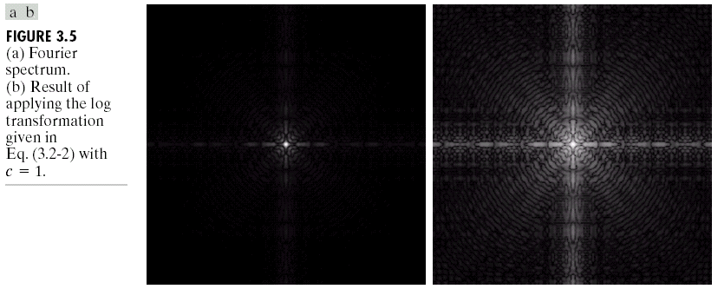
Log Transformation
s = c log(1+r)
c: constant
Compresses the dynamic range of images with large variations in pixel values

Slide 18
Logarithmic Transformations
Inverse Logarithm Transformation
Do opposite to the log transformations
Used to expand the values of high pixels in an image while compressing the darker-level values.

Slide 19
Power-Law Transformations
Power-law transformations have the basic form of:
s = c.r^{ᵞ}
Where c and ᵞ are positive constants

Slide 20
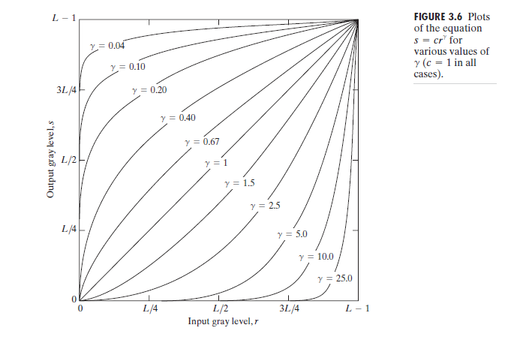
Power-Law Transformations
Different transformation curves are obtained by varying ᵞ (gamma)

Slide 21
Power-Law Transformations
Variety of devices used for image capture, printing and display respond according to a power law. The process used to correct this power-law response phenomena is called gamma correction.
For example, cathode ray tube (CRT) devices have an intensity-to-voltage response that is a power function, with exponents varying from approximately 1.8 to 2.5.With reference to the curve for g=2.5 in Fig. 3.6, we see that such display systems would tend to produce images that are darker than intended. This effect is illustrated in Fig. 3.7. Figure 3.7(a) shows a simple gray-scale linear wedge input into a CRT monitor. As expected, the output of the monitor appears darker than the input, as shown in Fig. 3.7(b). Gamma correction
in this case is straightforward. All we need to do is preprocess the input image before inputting it into the monitor by performing the transformation. The result is shown in Fig. 3.7(c).When input into the same monitor, this gamma-corrected input produces an output that is close in appearance to the original image, as shown in Fig. 3.7(d).

Slide 22
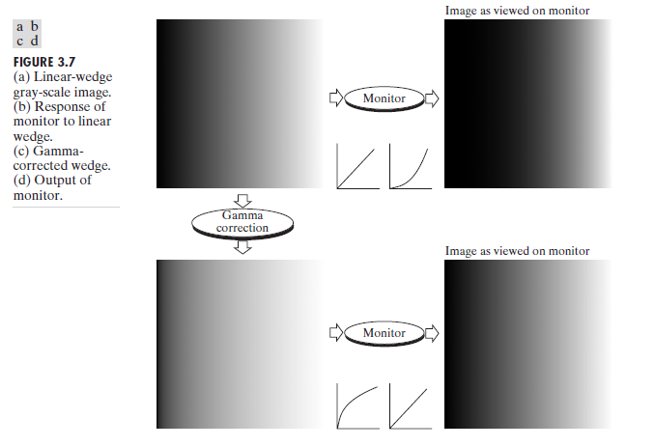
Power-Law Transformation

Slide 23
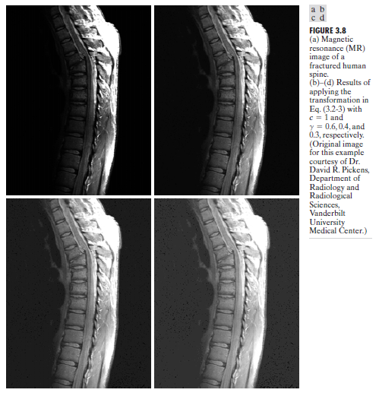
Power-Law Transformation
In addition to
gamma
correction,
power-law
transformations
are useful for
general-purpose
contrast
manipulation.
See figure 3.8

Slide 24
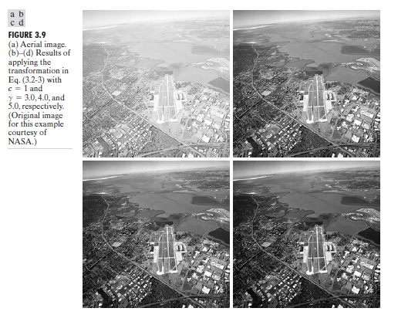
Power-Law Transformation
Another illustration of Power-law transformation

Slide 25
Piecewise-Linear Transformation Functions
Principle Advantage: Some important transformations can be formulated only as a piecewise function.
Principle Disadvantage: Their specification requires more user input that previous transformations
Types of Piecewise transformations are:
Contrast Stretching
Gray-level Slicing
Bit-plane slicing

Slide 26
Contrast Stretching
One of the simplest piecewise linear functions is a contrast-stretching transformation, which is used to enhance the low contrast images.
Low contrast images may result from:
Poor illumination
Wrong setting of lens aperture during image acquisition.

Slide 27
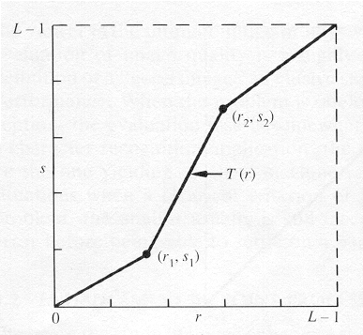
Contrast Stretching
To increase the dynamic range of the gray levels in the image being processed.

Slide 28
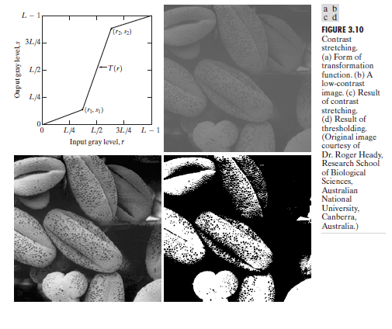
Contrast Stretching

Slide 29
Contrast Stretching
Figure 3.10(a) shows a typical transformation used for contrast stretching. The locations of points (r1, s1) and (r2, s2) control the shape of the transformation function.
If r1 = s1 and r2 = s2, the transformation is a linear function that produces no changes in gray levels.
If r1 = r2, s1 = 0 and s2 = L-1, the transformation becomes a thresholding function that creates a binary image. As shown previously in slide 7.
Intermediate values of (r1, s1) and (r2, s2) produce various degrees of spread in the gray levels of the output image, thus affecting its contrast.
In general, r1 ≤ r2 and s1 ≤ s2 is assumed, so the function is always increasing.

Slide 30
Contrast Stretching
Figure 3.10(b) shows an 8-bit image with low contrast.
Fig. 3.10(c) shows the result of contrast stretching, obtained by setting (r1, s1) = (r_{min}, 0) and (r2, s2) = (r_{max},L-1) where r_{min} and r_{max} denote the minimum and maximum gray levels in the image, respectively. Thus, the transformation function stretched the levels linearly from their original range to the full range [0, L-1].
Finally, Fig. 3.10(d) shows the result of using the thresholding function defined previously, with r1=r2=m, the mean gray level in the image.

Slide 31
Gray-level Slicing
This technique is used to highlight a specific range of gray levels in a given image. It can be implemented in several ways, but the two basic themes are:
One approach is to display a high value for all gray levels in the range of interest and a low value for all other gray levels. This transformation, shown in Fig 3.11 (a), produces a binary image.
The second approach, based on the transformation shown in Fig 3.11 (b), brightens the desired range of gray levels but preserves gray levels unchanged.
Fig 3.11 (c) shows a gray scale image, and fig 3.11 (d) shows the result of using the transformation in Fig 3.11 (a).

Slide 32
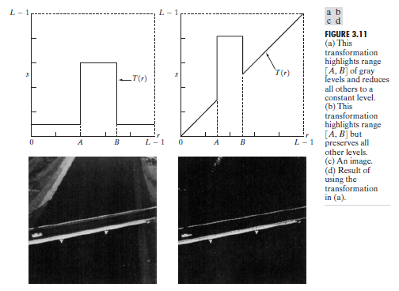
Gray-level Slicing

Slide 33
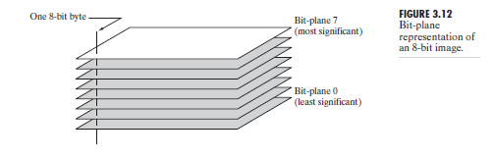
Bit-plane Slicing
Pixels are digital numbers, each one composed of bits. Instead of highlighting gray-level range, we could highlight the contribution made by each bit.
This method is useful and used in image compression.
Most significant bits contain the majority of visually significant data.

Slide 34
Bit-Plane Slicing
To highlight the contribution made to the total image appearance by specific bits.
i.e. Assuming that each pixel is represented by 8 bits, the image is composed of 8 1-bit planes.
Plane 0 contains the least significant bit and plane 7 contains the most significant bit.
Only the higher order bits (top four) contain visually significant data. The other bit planes contribute the more subtle details.

Slide 35
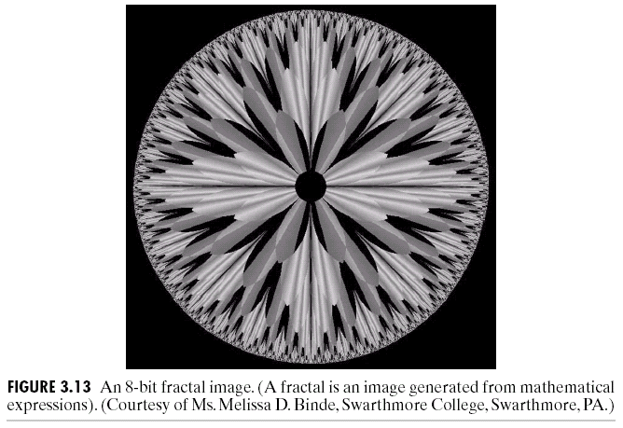
Illustration

Slide 36
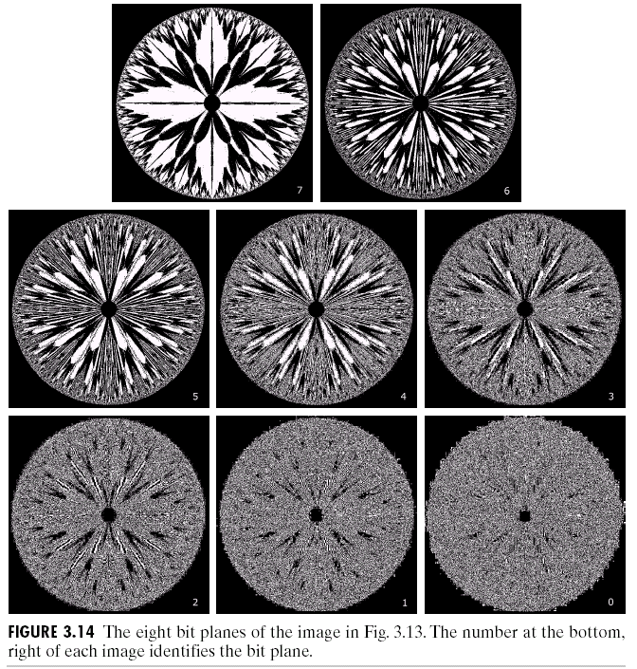

Slide 37
Histogram Processing
The histogram of a digital image with gray levels from 0 to L-1 is a discrete function h(r_{k})=n_{k}, where:
r_{k} is the kth gray level
n_{k} is the # pixels in the image with that gray level
n is the total number of pixels in the image
k = 0, 1, 2, …, L-1
Normalized histogram: p(r_{k})=n_{k}/n
sum of all components = 1

Slide 38
Types of processing:
Histogram equalization
Histogram matching (specification)
Local enhancement

Slide 39
Histogram Equalization
Histogram equalization (HE) results are similar to contrast stretching but offer the advantage of full automation, since HE automatically determines a transformation function to produce a new image with a uniform histogram.

Slide 40
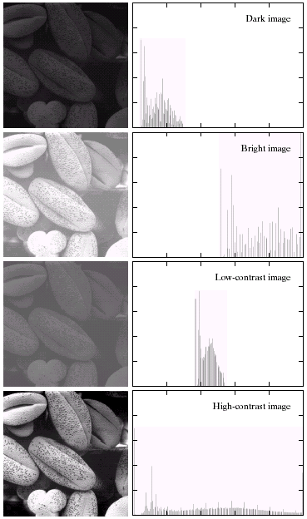
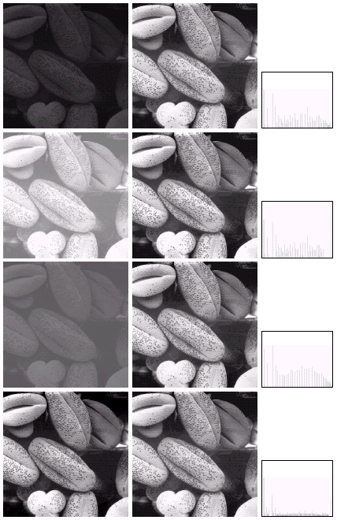
Image Histogram
Image Equalized Histogram

Slide 41
Histogram Matching (or Specification)
Histogram equalization does not allow interactive image enhancement and generates only one result: an approximation to a uniform histogram.
Sometimes though, we need to be able to specify particular histogram shapes capable of highlighting certain gray-level ranges.

Slide 42
Method
Specify the desired density function and obtain the transformation function G(z):
pz: specified desirable PDF for output
Apply the inverse transformation function z=G⁻¹(s) to the levels obtained in step 1.

Slide 43
Image Smoothing or Averaging
A noisy image:
Averaging M different noisy images:
As M increases, the variability of the pixel values at each location decreases.
This means that g(x,y) approaches f(x,y) as the number of noisy images used in the averaging process increases.

Slide 44
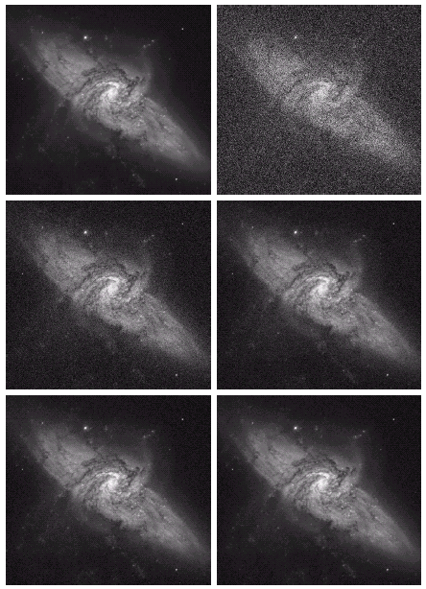
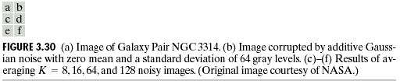
Example

Slide 45
Limitations of Averaging Filter
It leads to blurring of an image. Blurring affects feature localization.
When averaging operation applied to an image corrupted by impulse noise then the impulse noise is attenuated and diffused but not removed.
A single pixel, with a very distinct value can affect the mean value of all the pixels in its neighbourhood significantly.

Slide 46
Spatial Filtering
Use of spatial masks for image processing (spatial filters)
Linear and nonlinear filters
Low-pass filters eliminate or attenuate high frequency components in the frequency domain (sharp image details), and result in image blurring.

Slide 47
a=(m-1)/2 and b=(n-1)/2,
m x n (odd numbers)
For x=0,1,…,M-1 and y=0,1,…,N-1
The basic approach is to sum products between the mask coefficients and the intensities of the pixels under the mask at a specific location in the image:
(for a 3 x 3 filter)

Slide 48
Neighborhood Averaging

Slide 49
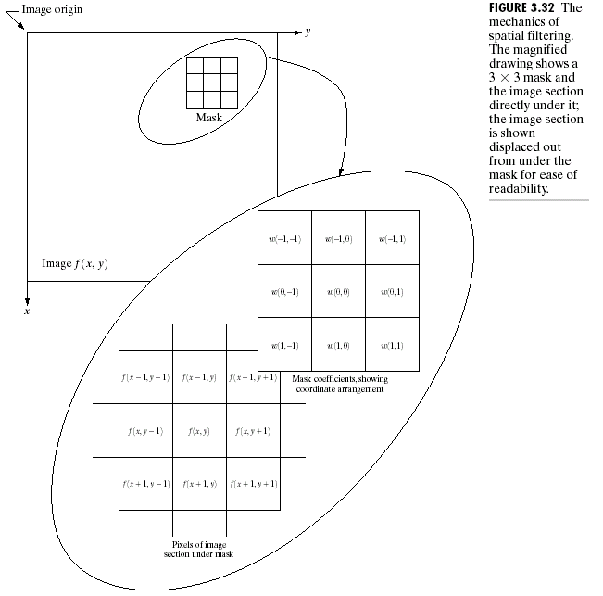
Spatial Domain Enhancement

Slide 50
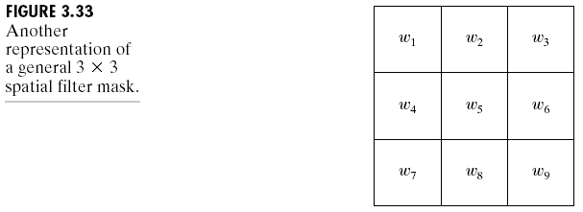
General Spatial Filter

Slide 51
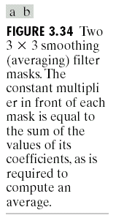
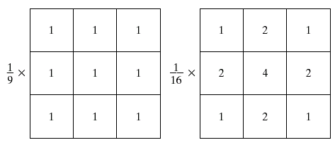
Smoothing(Averaging) Filters

Slide 52
Non-linear Filter
Median filtering (nonlinear)
Used primarily for noise reduction (eliminates isolated spikes)
The gray level of each pixel is replaced by the median of the gray levels in the neighborhood of that pixel (instead of by the average as before).

Slide 53
Illustration

Slide 54
Sharpening Filters
The main aim in image sharpening is to highlight fine detail in the image
With image sharpening, we want to enhance the high-frequency components

Slide 55
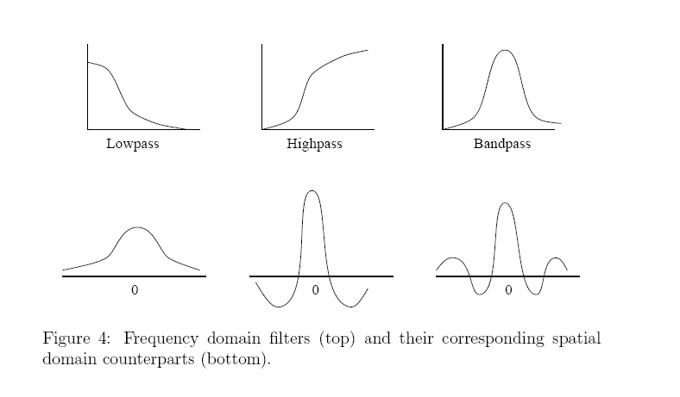
Frequency Domain filter

Slide 56
Frequency Domain filter
Frequency refers to the rate of repetition of some periodic event.
In Image processing spatial frequency refers to the variation of image brightness with its position in space.
Fourier Transform is a tool to obtain the frequency components.
If we multiply each element of the fourier coefficient by a suitably chosen weighting function then we can accentuate certain frequency components and attenuate others. The corresponding changes in the spatial domain can be seen after an inverse transform is computed.
This selective enhancement or suppression of frequency components is termed as Fourier Filtering or Frequency domain filtering.

Slide 57
Frequency Domain filter
The spatial representation of image data describes the adjacency relationship between pixels.
On the other hand, the frequency domain representation clusters the image data according to their frequency distribution.

Slide 58
Filtering
Let input image be f(m,n) and filter kernel be h(m,n)
Filtering in spatial domain=f(m,n)*h(m,n)
Filtering in frequency domain=F(k,l)xH(k,l)

Slide 59
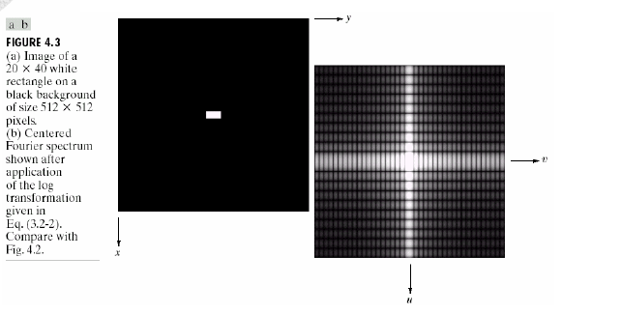
Image Enhancement in Frequency domain

Slide 60
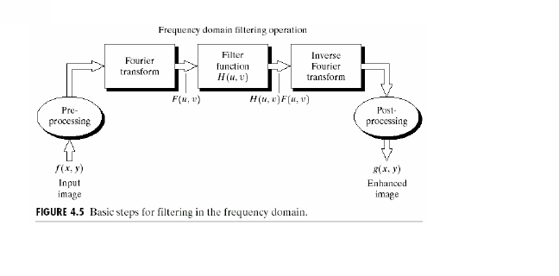
Image Enhancement in Frequency domain

Slide 61
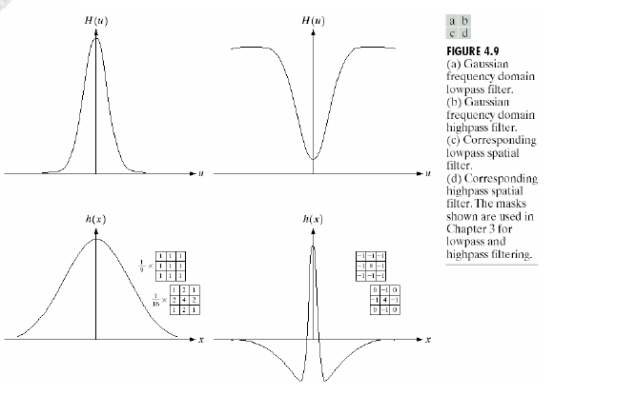
Image Enhancement in Frequency domain

Slide 62
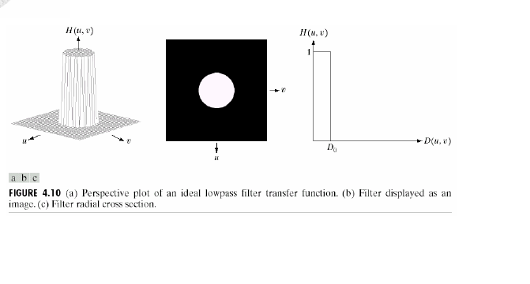
Ideal LPF

Slide 63
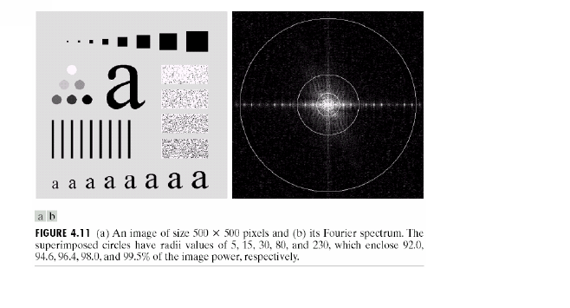
Image Enhancement in Frequency domain

Slide 64
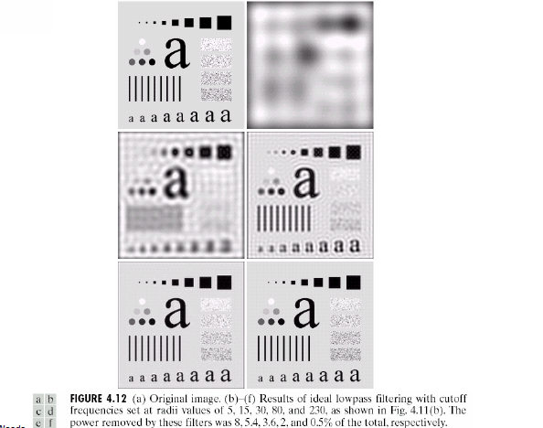
Contd…

Slide 65
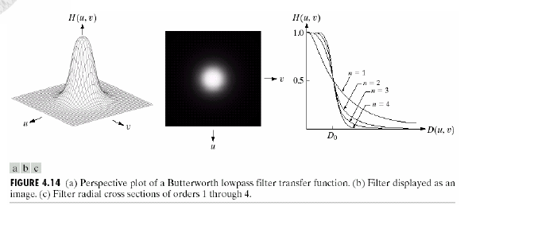
Contd…

Slide 66
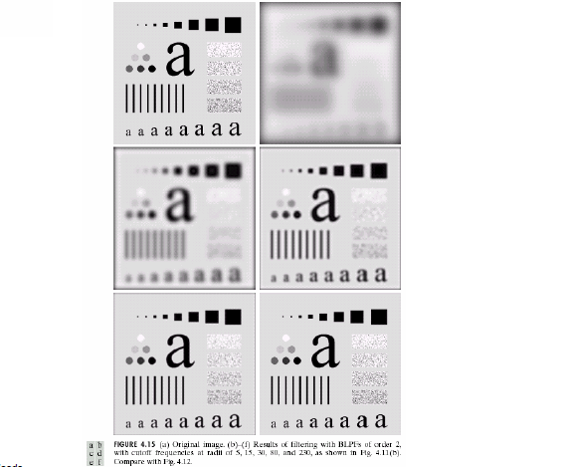
Contd..

Slide 67
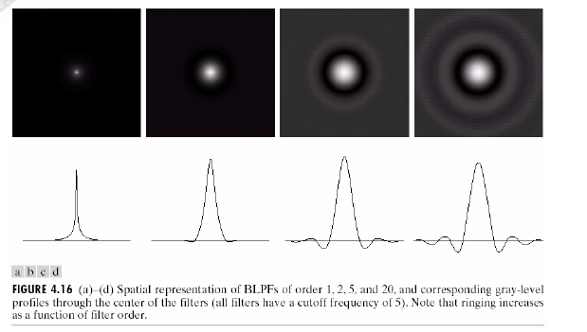
Contd…

Slide 68
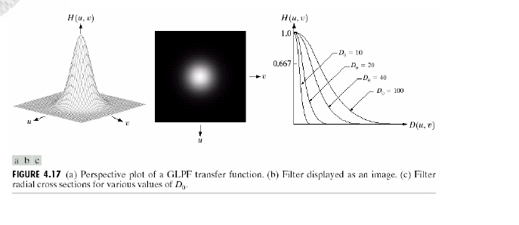
Contdd..

Slide 69
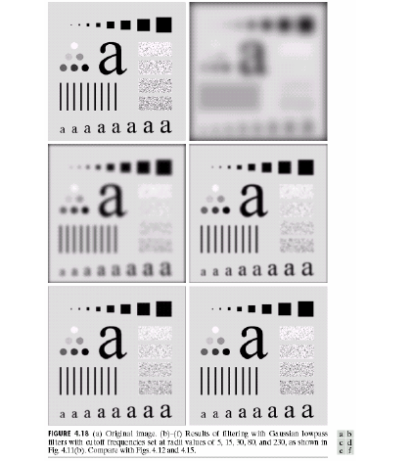
Contd..

Slide 70
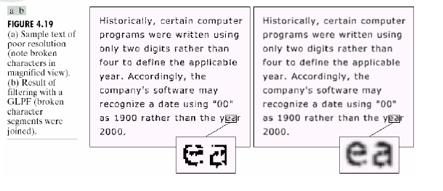
Contd..

Slide 71
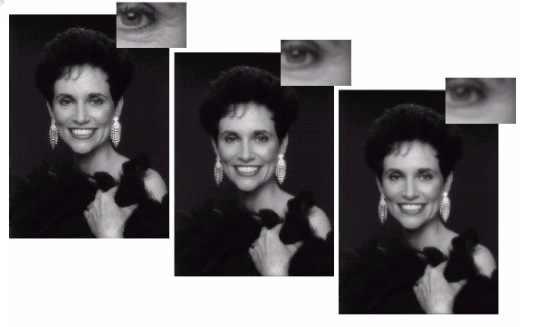
Contd…

Slide 72
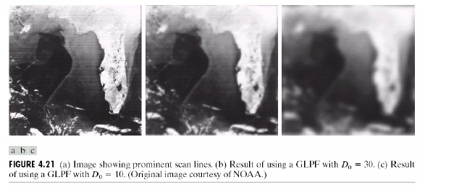
Contd…

Slide 73
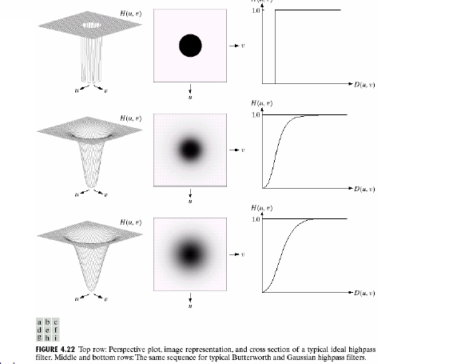
Contd…

Slide 76
Derivatives
First derivative
Second derivative

Slide 77
Observations
1st order derivatives produce thicker edges in an image
2nd order derivatives have stronger response to fine detail
1st order derivatives have stronger response to a gray level step
2nd order derivatives produce a double response at step changes in gray level

Slide 78
Since the sum of all the weights is zero, the resulting signal will have a zero DC value

Slide 79
Frequency Domain Methods
We simply compute the Fourier transform of the image to be enhanced, multiply the result by a filter (rather than convolve in the spatial domain), and take the inverse transform to produce the enhanced image.
Low pass filtering involves the elimination of the high frequency components in the image. It results in blurring of the image

Slide 80
Frequency Domain Methods

